Slide 1
Early Detection of Chronic Kidney Disease using Extreme Learning Machine
Research Project : Advanced Biomedical Informatics
Moh. Faturrahman
1506706276
Master Student of Computer Science University of Indonesia

Slide 2
Outline....
Pendahuluan
Metode
Eksperimen
Kesimpulan

Slide 3
Penyakit Ginjal Kronis
Gagal Ginjal Kronis adalah adanya tanda-tanda kerusakan ginjal (Abnormalitas dalam darah, urin, CT/Scan) > 3 Bulan,
atau Glomelural Filtration rate < 60 ML/minute, 1.73 m2 > 3 Bulan, dengan atau tidak didahului tanda-tanda kerusakan Ginjal
Notes:
In Slide Show mode, click the arrow to enter the PowerPoint Getting Started Center.

Slide 4
Prevalensi Penyakit Ginjal Akut di Indonesia

Slide 5
Prevalensi Lainnya

Slide 6
Chronic Kidney Disease could increase :
Cardiovascular Disease
Hypertension
Mineral and Bone Disorder
Anemia
Mortality
Progression to End Stage Renal

Slide 7
Dampak Lainnya
Beberapa kasus, penyakit Ginjal tidak didahului gejala.
Jika sudah pada level akut, Pasien harus melakukan cuci darah.
Tidak dapat sembuh, hanya mempertahankan kualitas hidup
Transpalansi Ginjal

Slide 8
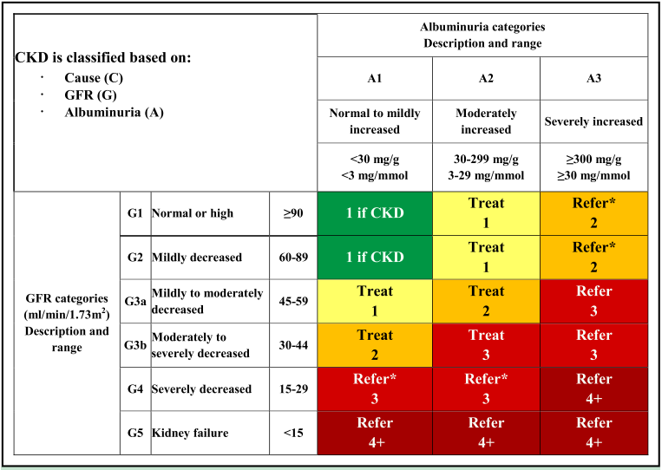

Slide 9
Pentingnya Deteksi Dini Ginjal
Menekan Resiko Komplikasi
Memperlambat Proses menuju Stadium Lanjut,
Memberikan perawatan dan pengobatan yang sesuai.

Slide 10
Tinjauan Pustaka
Penulis | Judul | Tahun | Metode | Accuracy
Zewen Chen et al, | Diagnosis of patients with chronic kidney disease by using two fuzzy classifier | 2016 | Fuzzy Classifier | 98%
Chetty et al | Role of Attributes Selection in Classification of Chronic Kidney Disease Patients | 2015 | Naive Bayes, SMO, IBk | 99%,98.25%, 100%
Guanjing Wang et al | Prediction of mortality after radical cystectomy for bladder cancer by machine learning techniques | 2015 | ELM, RELM | 80%
Ismaeel et al | Using the Extreme Learning Machine (ELM) Technique for Heart Disease Diagnosis | 2015 | ELM | 80%
Zhu Hong Yu et al | Prediction of Protein-Protein Interactions from Amino Acid Sequences using Extreme Learning Machine Combined with Auto Covariance Descriptor Zhu-Hong | 2013 | ELM | 90.42%

Slide 11
Extreme Learning Machine
Fast Algorithm
Minimum Training Error and Smallest Norm of Weight
Non differentiable Activation Function
Local Minima, Overfitting, Improper learning rate

Slide 12
Tujuan :
Mengukur peforma Akurasi, Sensitivity, Specificity, ELM dalam memprediksi penyakit Ginjal Kronis

Slide 13
Methods
TRAINING DATA
TRAINING DATA
TRAINING DATA
TRAINING DATA
TRAINING DATA
Training
ML Algorithms
Clinical Data
Preprocessing Data
K-Fold
Classification Model
No
TESTING DATA
TESTING DATA
TESTING DATA
TESTING DATA
Testing
TESTING DATA
Good Performance ACC, SP,SN,PR ?
REPORT & ANALYSIS
Evaluation

Slide 14
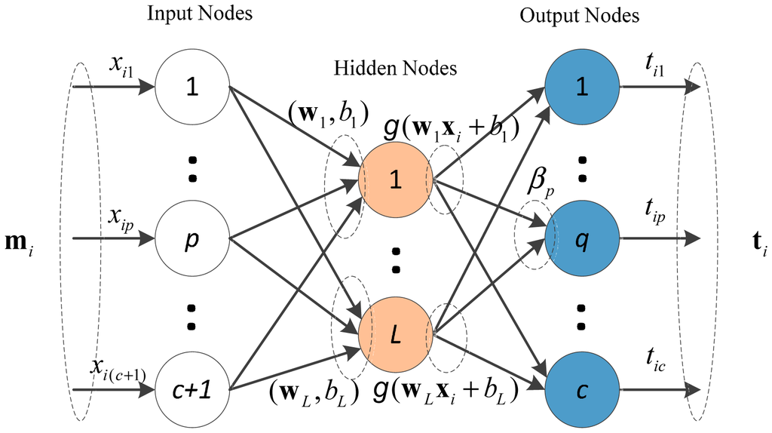
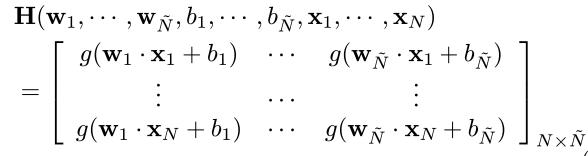
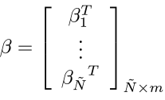
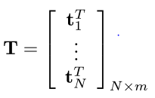


Extreme Learning Machine

Slide 15
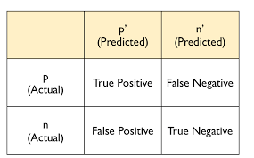
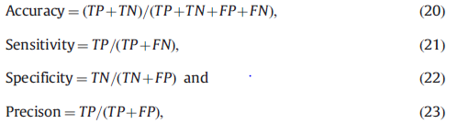
Evaluation

Slide 16
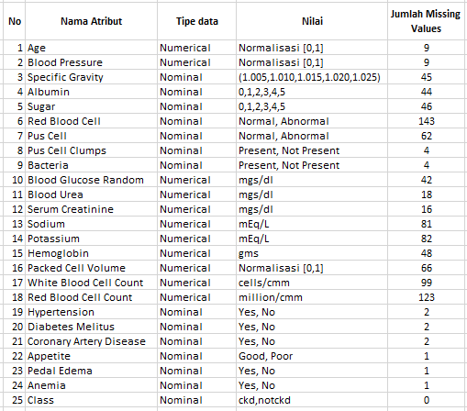
Dataset
Diambil dari UCI Machine Learning Repository
400 Data record pasien
25 Attributes, 11 Numeric and 14 Nominal
2 Kelas, CKD dan NOTCKD

Slide 17
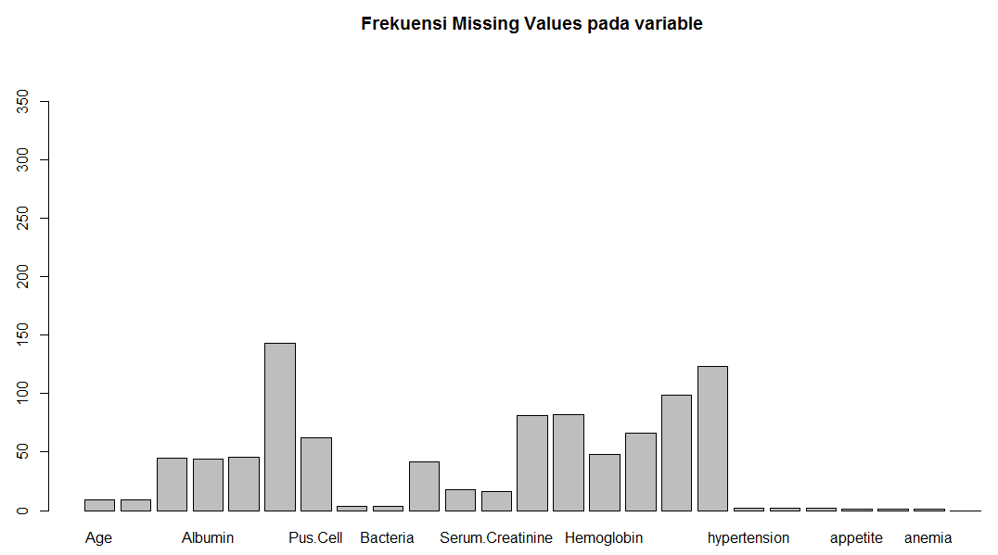
Dataset

Slide 18
Perangkat Pendukung
CPU Core i7 5TH, RAM 4GB, Win 64 Bit
Bahasa R, R Studio.
Package Library Caret

Slide 19
Kesimpulan
Penyakit Ginjal Kronis memiliki resiko terjadi Komplikasi
Deteksi Dini dapat mengurangi resiko komplikasi dan progress penyakit
Pemeriksaan Lab, memiliki kekurangan, seperti biaya yang mahal, terdiri dari banyak tes,
ELM berpotensi sebagai solusi dalam mendeteksi penyakit Ginjal Akut, dan mendukung fungsi tenaga medis untuk mengambil keputusan.

Slide 20
Reference

